Slide 1
A Real World Example of Decision Support Systems Software
By: Vahid Moeinifar
AGH University of Krakow

Slide 2

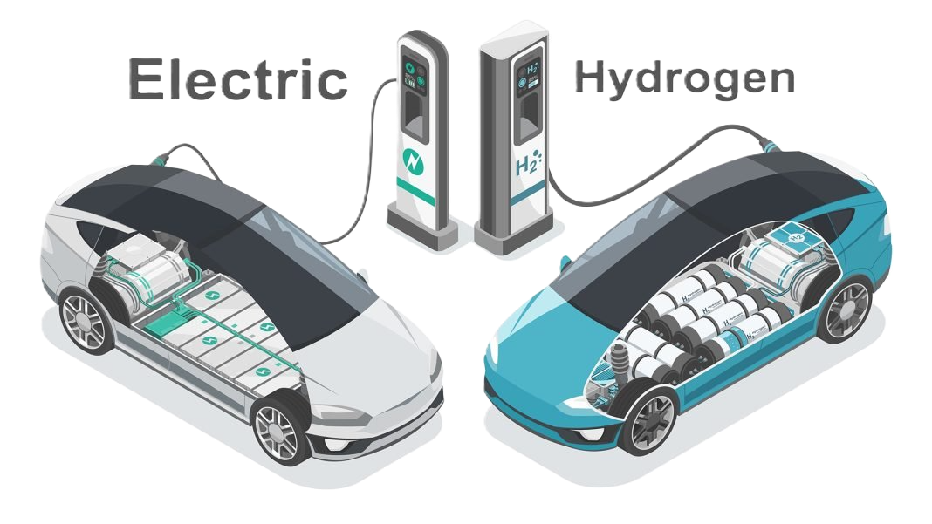
Real-World Problem — A Strategic Green Energy Decision
Scenario:
A major car manufacturer must decide where to invest billions — in ⚡ Electric Vehicles (EVs) or 🔋 Hydrogen Fuel Cell Vehicles (HFCVs).
Why it’s difficult: Each option has advantages, drawbacks, and uncertain future outcomes. The decision isn’t just technical — it’s economic, environmental, and strategic.

Slide 3
Now, let us examine the advantages and disadvantages of each option.
Criteria | Electric Cars (EV) | Hydrogen Fuel Cars (HFCV)
Max Range | Improving, but still limited by battery | Typically higher (e.g. 600 km)
Vehicle Cost | Currently higher, may decrease with tech | Currently lower
Energy Efficiency | High, but drops in cold weather | Moderate
Refueling/Charging | Charging infrastructure expanding | Hydrogen stations are rare, expensive
Environmental Impact | Cleaner if powered by renewables | Clean if hydrogen is green (not fossil-based)
Future Potential | Strong R&D, decreasing cost trend | Promising but infrastructure barrier

Slide 4


The Decision Challenge
This is not a simple yes/no decision — it’s a multi-criteria problem:
The company must consider:
🔋 Technical performance (range, safety, reliability)
💰 Economic factors (cost, investment, future price trends)
🌍 Environmental impact (carbon footprint, energy source)
🏗️ Infrastructure needs (charging vs hydrogen stations)
⏳ Long-term sustainability & innovation potential
Too many factors → too much uncertainty → high risk.

Slide 5

How a DSS Can Help
A Decision Support System (DSS) can:
Model and quantify all relevant criteria (costs, risks, emissions, etc.)
Apply Multi-Criteria Decision-Making (MCDM) methods (AHP, TOPSIS, etc.) to rank alternatives.
Simulate future scenarios — e.g., what if battery cost drops 30%?
Visualize trade-offs — cost vs sustainability vs infrastructure readiness.
Support collaboration between engineers, economists, and sustainability experts.
Result: A transparent, data-driven recommendation on whether EV or Hydrogen provides better long-term sustainability and ROI.

Slide 6

Example Output of a DSS
a simple bar chart or radar chart with example scores:
Criterion | Weight | EV Score | HFCV Score
Cost | 0.3 | 6 | 8
Range | 0.2 | 7 | 9
Environmental Impact | 0.3 | 9 | 7
Infrastructure | 0.2 | 8 | 5
Total Weighted Score | — | 7.8 | 7.3
Interpretation: DSS suggests EVs are currently the better long-term sustainable investment, despite higher initial cost.

Slide 7
So…
Many major corporations already use Decision Support Systems — not just for finance or logistics, but also for sustainable energy management. Toyota uses DSS to plan EV production, Shell for renewable portfolio decisions, Amazon for carbon-efficient logistics, and Siemens for smart energy systems.
Decision Support Systems are used across many industries — not only energy. Here are five real-world examples from other domains:
Healthcare: Clinical DSS helps doctors diagnose diseases, choose treatments, and predict patient risks (e.g., IBM Watson Health).
Finance: Banks use DSS for credit risk assessment, fraud detection, and investment portfolio optimization.
Agriculture: Farmers apply DSS to decide optimal irrigation, crop rotation, and fertilizer use for sustainable yields.
Transportation & Logistics: DSS systems optimize delivery routes, fleet management, and fuel efficiency (e.g., UPS’s ORION system).
Disaster Management: Governments and NGOs use DSS for flood prediction, evacuation planning, and emergency resource allocation.

